Slide 1

Investor Pitch for Ecoarmor
Ecoarmor: The Compostable Phone Case Revolution

Slide 2
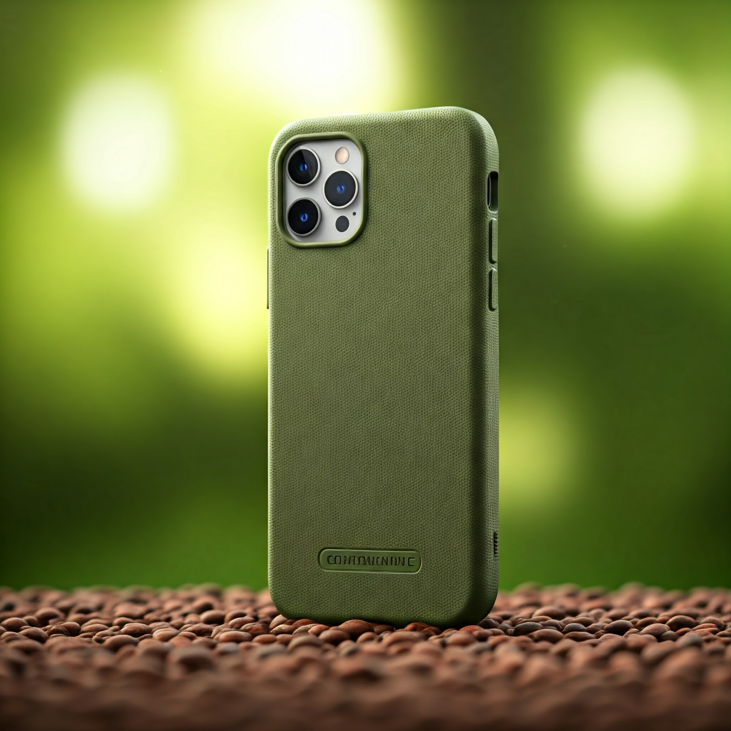
Introduction
• Overview:
Ecoarmor is a compostable phone case designed for eco-conscious consumers.
To revolutionize the tech accessory market with eco-friendly solutions.

Slide 3

The Problem
• Challenges with Regular Phone Cases:
- Non-biodegradable, leading to significant plastic waste.
- Harmful to the environment during production and disposal.
• Demand for Change:
- Growing consumer interest in sustainable and eco-conscious products.

Slide 4
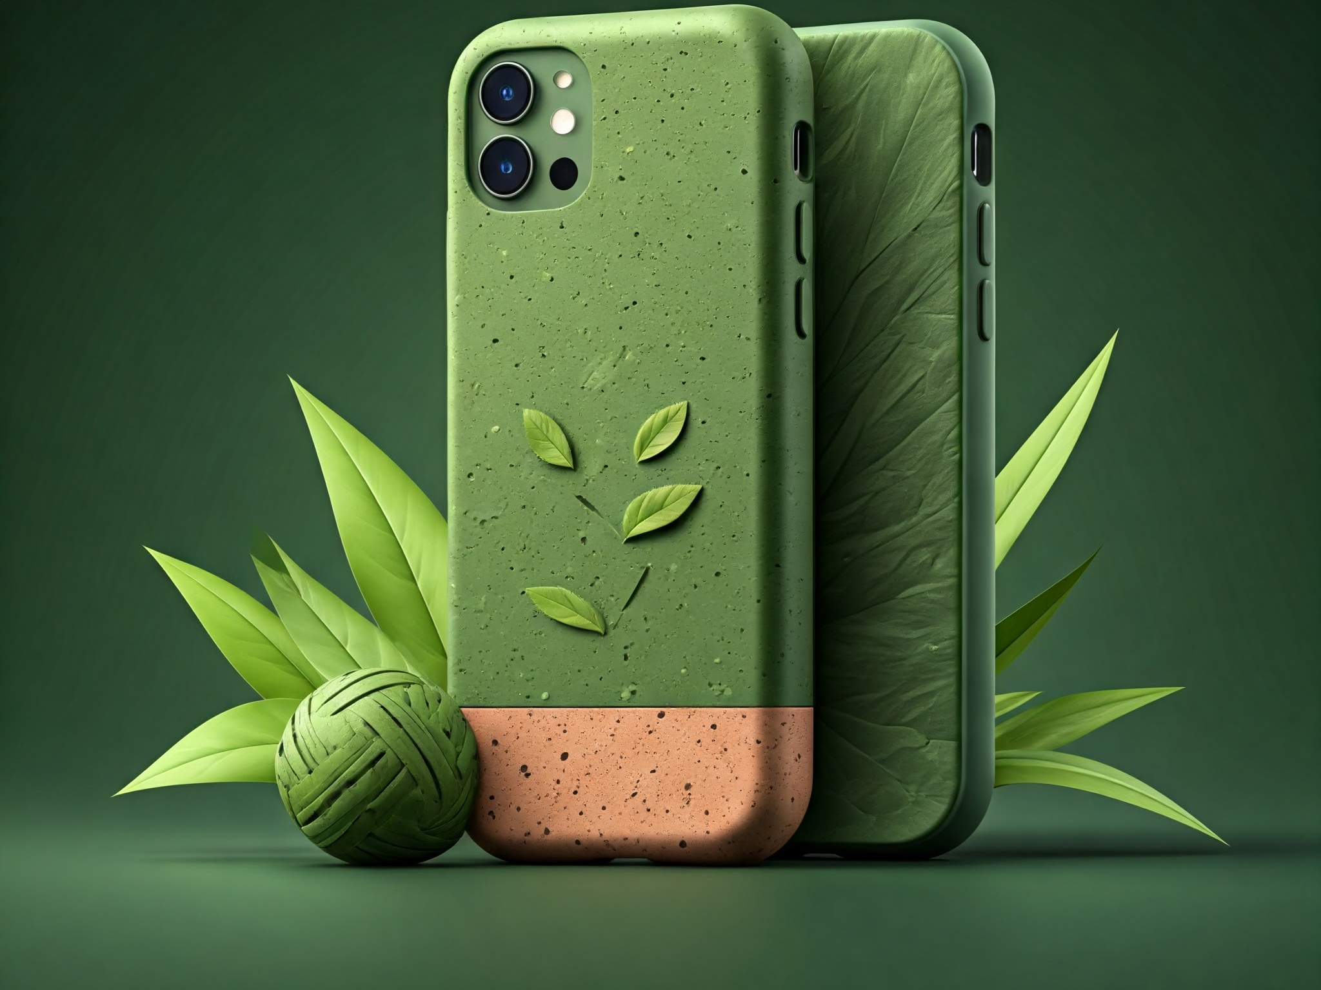
The Solution: Ecoarmor
• Key Features of Ecoarmor:
- Made from 100% compostable materials.
- Sleek, modern, and protective design.
- Certified biodegradable and toxin-free.
• Why Ecoarmor Stands Out:
- Combines functionality with sustainability.
- Reduces your carbon footprint without compromising style.

Slide 5

Market Opportunity
• Market Insights:
- Tech accessories market valued at $XX billion.
- Eco-conscious consumer segment growing by XX% annually.
• Target Audience:
- Tech-savvy, environmentally aware individuals aged 18-45.
- Early adopters and socially responsible consumers.
• Potential:
- A vast untapped market for sustainable tech accessories.

Slide 6

Business Model
• Revenue Streams:
- Direct-to-consumer sales via online platforms.
- Partnerships with eco-conscious retailers and stores.
- Licensing biodegradable technology to other brands.
• Pricing Strategy:
- Positioned as premium yet affordable compared to traditional phone cases.

Slide 7

Marketing & Growth Strategy
• Branding and Positioning: Luxury and practicality.
• Digital Marketing: Focus on social media ads, influencer collaborations, and eco-themed campaigns.
• Expansion Plans:
- Enter international markets starting with eco-conscious regions like Europe and North America.
- Diversify into accessories like compostable earbuds cases.

Slide 8

Financial Projections
• Revenue Forecast:
- Year 1: $X million
- Year 3: $X million (targeted growth rate of XX%).
• Break-even Analysis:
- Expected to achieve break-even in Year 2 with scaled operations.
• Funding Allocation:
- R&D: XX%
- Marketing: XX%
- Scaling production: XX%

Slide 9

The Team
• Founders and Key Team Members:
SRIKOTI SIRI KRISHNA

Slide 10

Why Invest in Ecoarmor?
• Strong Market Opportunity:
- The rising demand for eco-conscious products.
• Unique Product:
- Compostable material with proven performance.
• Scalable Business Model:
- High potential ROI and growth in the sustainable accessories market.

Slide 11
Q&A and Closing Remarks
• Open floor for questions.
• Thank you for your time and interest.
• Contact Information:
- Email: srikotisirikrishna@gmail.com

Slide 12
Prompt used
you are an expert in creating power point presentations. You are tasked to do a attractive and informative investor pitch ppt with information and pictures related to a product called ecoarmor a compostable phone case ,use formal colors for words. The information should be each separate slide as provided and the output should be ppt file :
Slide 1:Investor pitch on Ecoarmor with a slogn
Example: Investor Pitch for Evolens
The Adaptive Sunglass Revolution
Slide 2:Introduction
• Welcome and introduction
•Overview of Evolens
• Mission: Redefining eyewear with adaptive technology
Slide 3:The Problem
• Challenges with regular phone cases: - Discomfort for environment
• Increasing demand for smart, adaptable products
Slide 4:The Solution: Ecoarmor
Slide 5:Market Opportunity
slide 6:Business Model
• Revenue streams: - Direct-to-consumer sales - Retail partnerships - Licensing technology • Pricing strategy: Premium yet competitive
Slide 7:Marketing & Growth Strategy
• Branding and positioning: Luxury and practicality • Digital marketing: Social media, influencers, and ads • Expansion plans: International markets and diverse product lines
Slide 8:Financial Projections
• Revenue forecast for 3-5 years • Break-even analysis • Funding allocation for R&D, marketing, and scaling
Slide 9:The Team
• Founders and key team members: - Expertise in product development, marketing, and operations • Advisors and partners: Adding credibility and support
Slide 10:Why Invest in Ecoarmor?
• Strong market opportunity and growth potential • Unique product with a competitive edge • Scalable business model with high ROI potential
Slide 11:Q&A and Closing Remarks
• Open floor for questions • Thank you for your time and interest • Contact information for follow-up

